Slide 1
CONTINUUM
ROBOT

Slide 2
PRESENTED BY-
Siddharth Mehrotra
Reg No-12006050
Roll No-Re2001A06
Section-E2001
Naman Thakur
Reg No-12017949
Roll No-Re2001A29
Section-E2001
Introduction to Artificial Intelligence

Slide 3
TABLE OF CONTENTS
01
02
03
04
05
06
MISSION STATEMENT
PROS & CONS
WHAT IS A CONTINUUM ROBOT?
SCHEMATIC
PROPOSED DESIGN
CONCLUSION

Slide 4
01
What is a continuum robot?

Slide 5
Continuum robots utilise discrete joints but combine very short rigid links with a large density of joints. This creates highly mobile mechanisms which appear to produce smooth curves, similar to a snake.

Slide 6
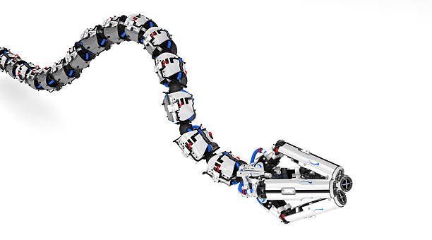
Continuum robots do not contain rigid links and identifiable rotational joints. Instead the structures bend continuously along their length via elastic deformation and produce motion through the generation of smooth curves, similar to the tentacles or tongues of the animal kingdom.

Slide 7
MISSION STATEMENT
Our Prime motto is to go into the depth of automation which can be achieved in a continuum robot.
We wish to continue the research going on in the field of continuum robot.
We would also like to explore if we can achieve an application oriented continuum robot.

Slide 8
PROS
CONS
Continuum robots can more easily operate in environments that require a high level of dexterity, adaptability and flexibility.
The simplicity of their structure makes continuum robots more prone to miniaturisation.
Continuum manipulators are made of highly compliant materials that are flexible and can adapt and deform according to the surrounding environment.
To properly and safely use continuum robots, it is crucial to have an accurate force and shape sensing system.
It is also necessary to notice that while the mechanical properties of rigid-link robots are fully understood, the comprehension of the behaviour and properties of continuum robots is still subject of study and debate.

Slide 9
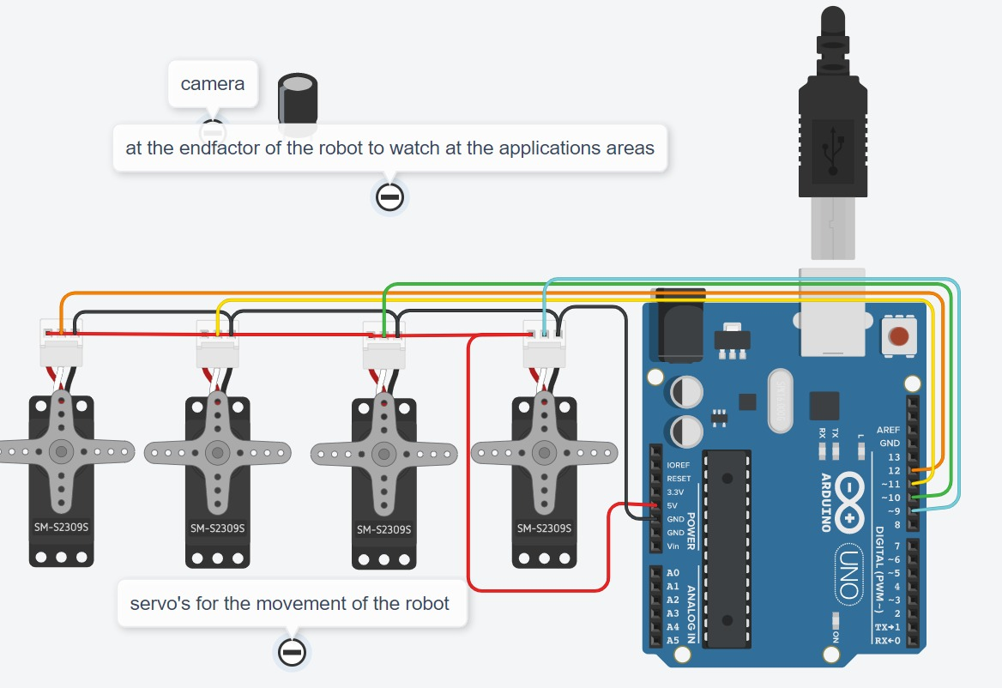
Schematic
This is our proposed circuit diagram which we will be implementing.

Slide 10
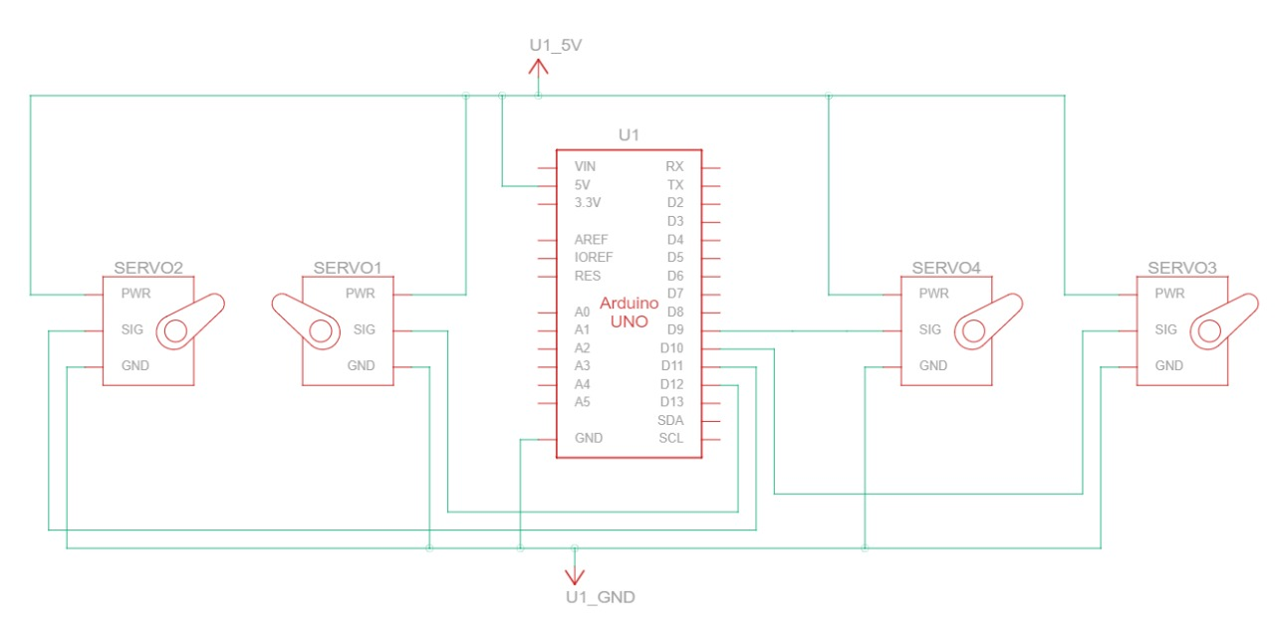
Schematic

Slide 11
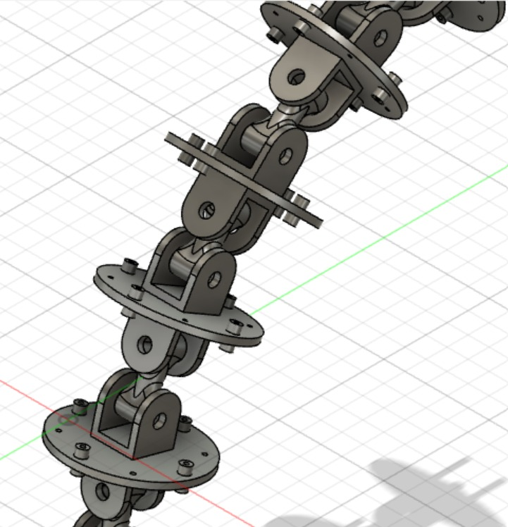
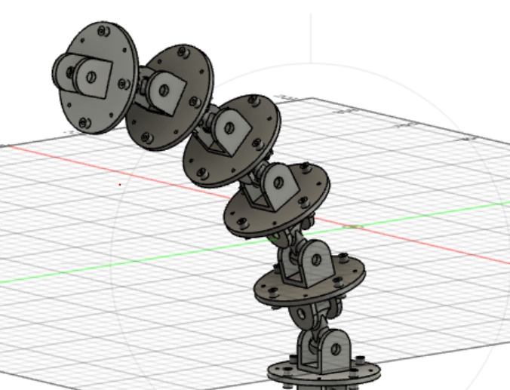
PROPOSED DESIGN

Slide 12
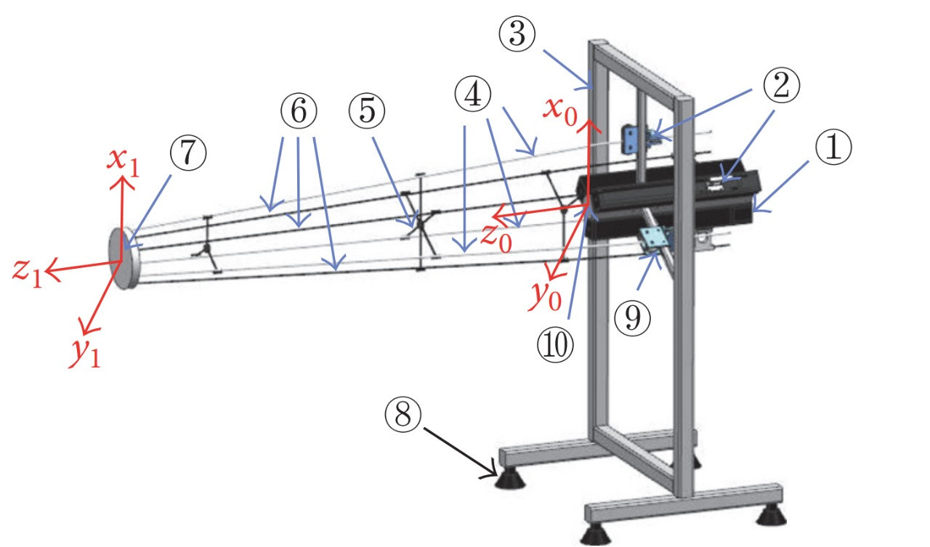
Kinematic view

Slide 13
COMPONENTS
STEPPER MOTOTR/SERVOS
ARDUINO
MOTOR DRIVER
CAMERA MODULE

Slide 14
CONCLUSION
Continuum robot research have ramped up in previous years with their usage finding more and more industry applications.
We have also tried our level best to continue the work being carried out all over the world.
Using continuum robots we can achieve automation in lot of applications and that is their biggest advantage.

Slide 15
THANKS!
ANY QUESTIONS?

